Slide 1
BASICS OF lighting
Understanding light, your camera, and how to take better pics

Slide 2
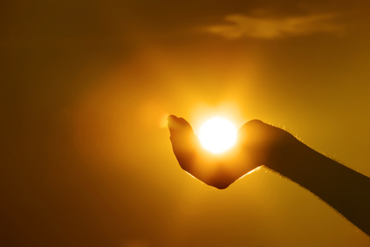
Notes:
-A Photograph, in essence, is the light reflected off of a subject, recorded by the lens of the camera onto the digital memory card, or the grains of film. Therefore, without light, photography cannot exist.

Slide 3
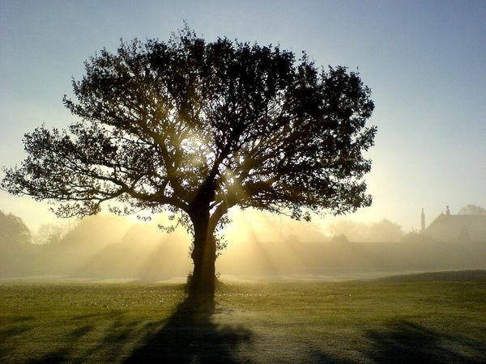
Finding the “right” light
Notes:
: Many people believe that shooting outdoors puts you at a disadvantage, since well…we cannot control the clouds, or the position of the sun, or the weather. All these affect the light, and therefore affect your photos.
-What really separates the pros for the wanna-bes, is being able to anticipate and solve lighting problems. Of course sometimes lighting issues cannot be helped, but understanding what CAUSES issues with light, will help you to better plan for your shoots, and take advantage of the “right” light.

Slide 4
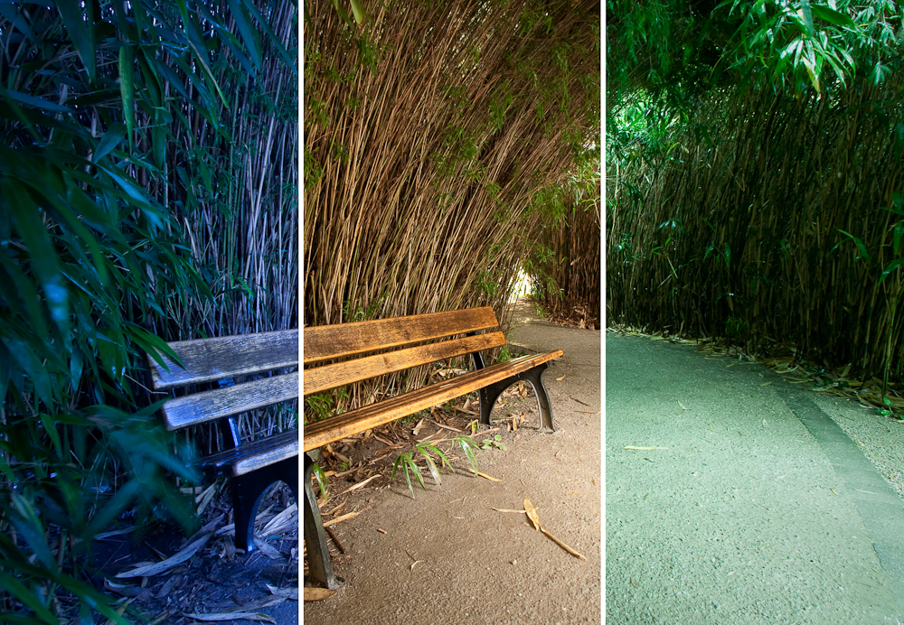
The color of light
Notes:
Temperature: (show an image in varying light temperatures) Color temperature is measured in degrees Kelvin, a temperature scale named in honor of the British physicist and engineer, William Thompson, Baron Kelvin. Different light sources cast a different temperature (color) of light. A break down of some of the varying color temps:

Slide 6
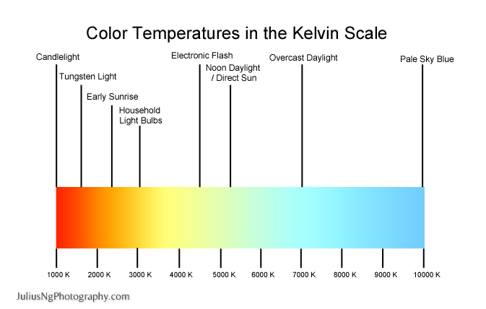
Notes:
Match flame 1700 to 1800°K
Candle flame 1850 to 1930°K
Sun: at sunrise or sunset 2000 to 3000°K
Household tungsten bulbs 2500 to 2900°K
Tungsten lamp 500W to 1Kw 3000°K
Quartz lights 3200 to 3500°K
Fluorescent lights 3200 to 7500°K
Tungsten lamp 2Kw 3275°K
Tungsten lamps 5Kw, 10Kw 3380°K
Sunlight: direct at noon 5000 to 5400°K
Daylight (sun + sky) 5500 to 6500°K
Sunlight (through haze/clouds) 5500 to 6500°K
Sky: overcast 6000 to 7500°K
RGB Monitor (White Pt) 6500°K
Outdoor shade 7000 to 8000°K
Sky: partly cloudy 8000 to 10000°K

Slide 7
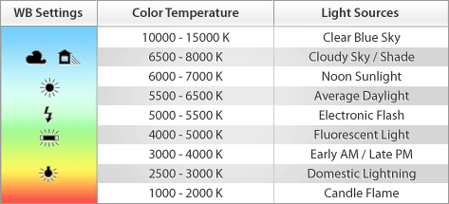
Notes:
When you don’t use the proper color temperature, this is referred to as a “white balance” issue. All cameras come with a way to adjust your WB or “white balance”. This is a major asset is taking pictures with the right color temperature, to prevent your subjects from looking unnatural.
-White balance (WB) is the process of removing unrealistic color cast, so those objects, which appear white in person, are rendered white in your photo. Most DSLRs give you a number of options to choose from on the WB Menu.

Slide 8
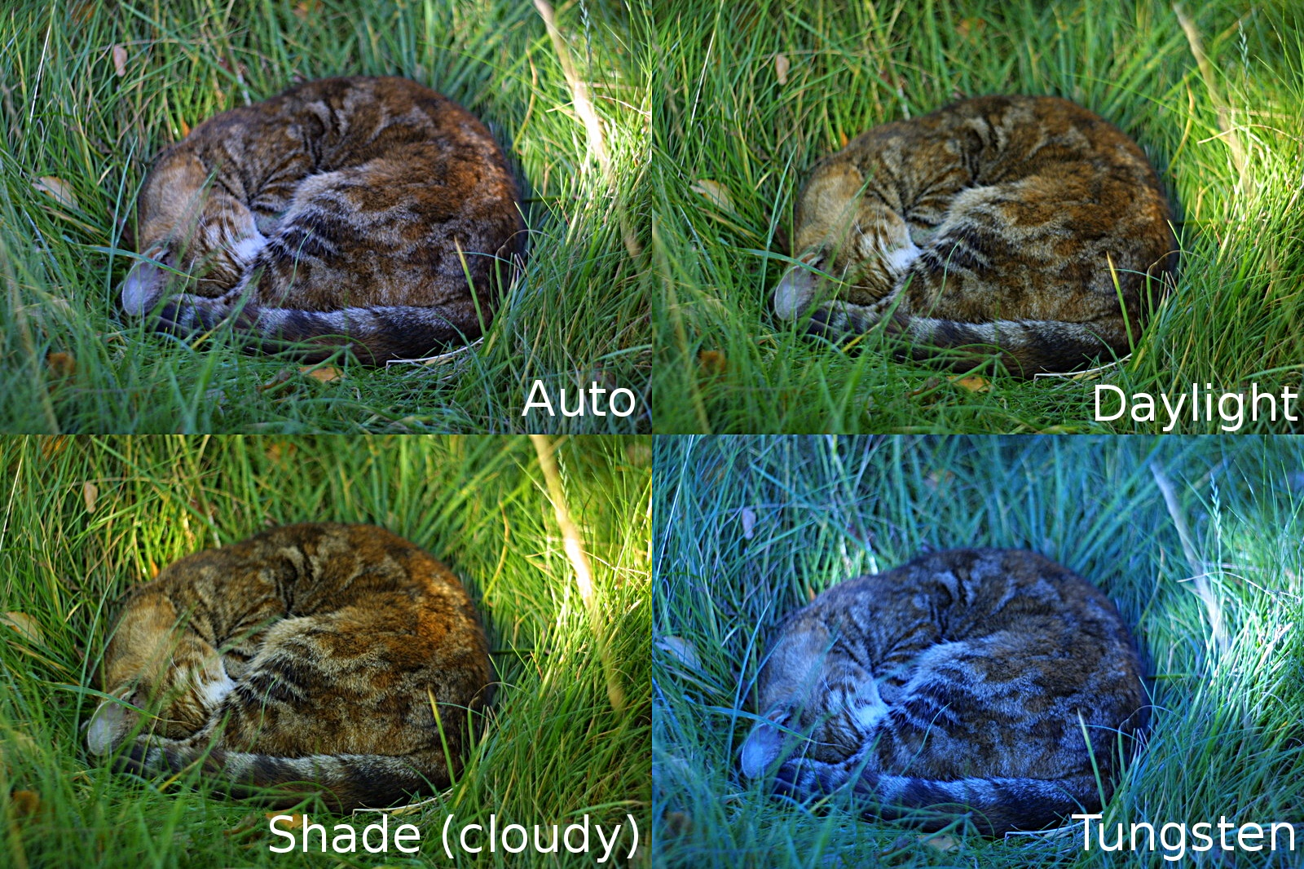
Notes:
Auto white balance is recommended for most shooting scenarios. Auto white balance employs an algorithm to calculate a best guess color temperature that fall somewhere between 3000 and 7000°K.

Slide 9
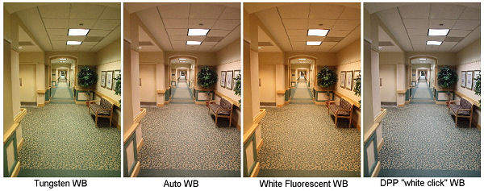
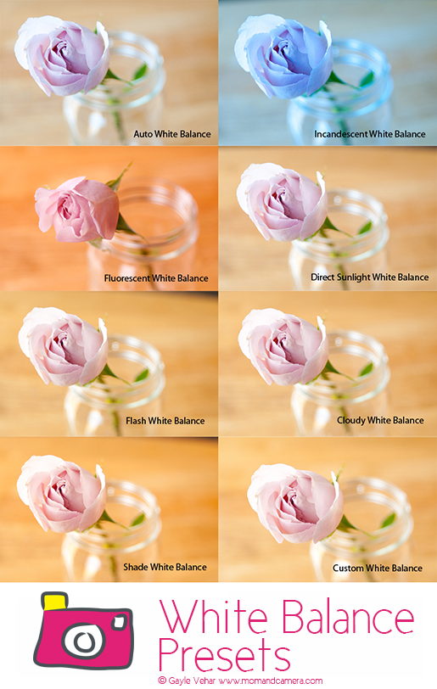
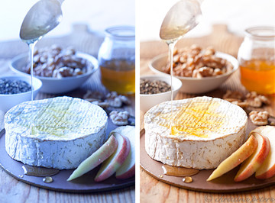

Slide 10
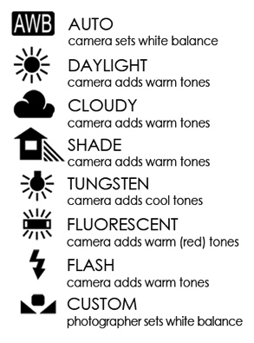
Notes:
AWB. In AWB mode, the camera takes a "best guess" option, usually choosing the brightest part of the image as the point that is white. This option is usually at its most accurate outside, with natural, ambient lighting.
Daylight. This is the white balance option for when the sun is at its brightest (around noon). It adds warm tones to the image to combat the very high color temperature.
Cloudy. The cloudy mode is for use when the sun is still out, with intermittent cloud cover. It still adds warm tones, but it takes into account the slightly cooler nature of the light.
Shade. You'll want to use the shade mode when your subject is in shadows on a sunny day, or when you encounter a cloudy, foggy, or dull day.
Tungsten. You should use the tungsten setting with normal household bulbs, which emit an orange color cast.
Fluorescent. When you encounter traditional fluorescent strip lights, you'll want to use the fluorescent mode. Fluorescent lights emit a green color cast. The camera adds red tones to combat this.
Flash. The flash mode is for use with speedlights, flashguns and some studio lighting.
Kelvin. Some DSLRs have the Kelvin mode option, which allows the photographer to set the exact color temperature setting that he or she wants.
Custom. The custom mode allows photographers to set the white balance themselves, using a test photograph.

Slide 12
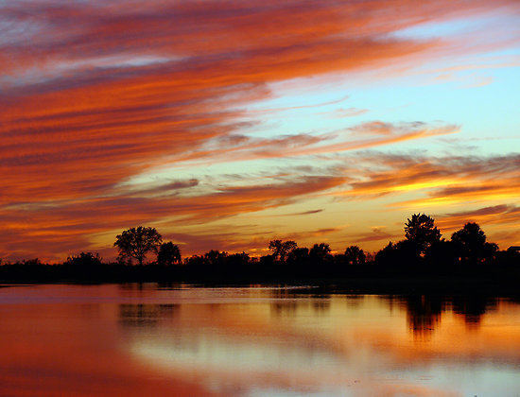
Quality of light
Notes:
As light changes in color, so too does it change in quality. Sometimes light can be hard, soft, direct, contrasty, diffused, etc. This is affected by a few issues such as time of day, cloud cover, obstructions, weather, to name a few. When working outdoors, it’s important to understand how your camera will react in different lighting situations, so you can better compensate or plan for the picture you want.

Slide 13
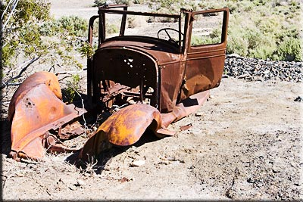
Hard light
Notes:
-Hard Light: When working outdoors, hard light is usually direct sunlight on a bright day, usually sometime mid day. In hard light, the light source is very bright, and it casts very hard deep shadows, while the brighter parts of the image tend to washed out or “over exposed”. This can create dramatic affects, and in color photos sometimes in can cause the colors to seem super saturated and bright. At times the affect of hard light can be too intense, and you get washed out colors due to the glare of the light. When working in hard light conditions, it’s important to understand the (ISO) or “digital film speed” this is how much light the lens allows in, it works in companion with shutter speed and exposure. (For DSLRs) for point and shoots, the camera does this for you.

Slide 14
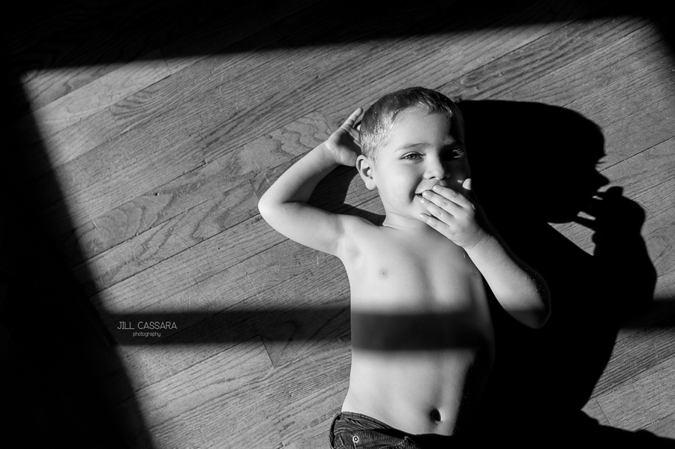

Slide 15
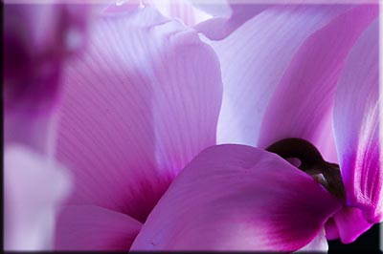
Soft light
Notes:
-Soft Light – Also called “diffused” light. This comes from shooting outside on a cloudy day. Instead of light coming from one direction, the light wraps around the subject evenly, causing very soft, (if any) shadows. There will be less contrast in the image, but it will be high detail. Soft light is great for documentary photography. Colors will be bright and true, except when the clouds are gray, which will soften all the colors in your image.

Slide 17
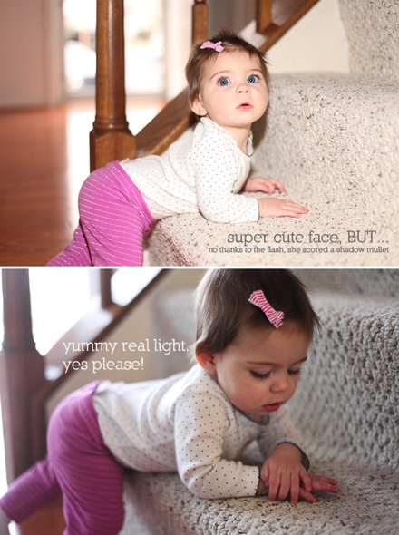

Slide 18
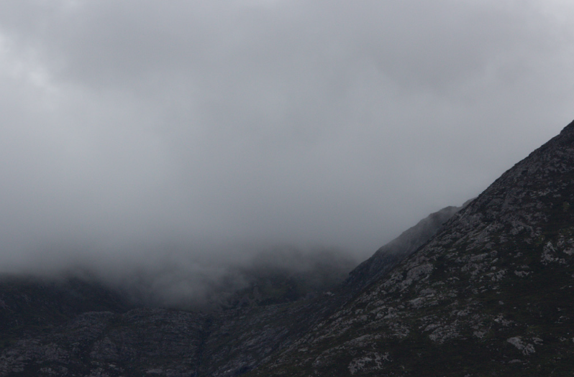
Haze, mist, fog
Notes:
-Haze, Mist, and Fog – On days that are hazy, misty, or foggy, there are particles in the air, which change the quality of light. Just like your eye sees differently, so does the lens. These particles in the air act as a “filter” which brings down the contrast, and makes colors look softer and more pastel. Images shot this way are often moody, and portray a sense of atmosphere. Colors will seldom be rich, except maybe in the foreground of your images.

Slide 19
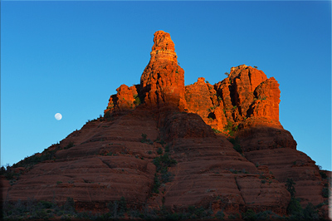
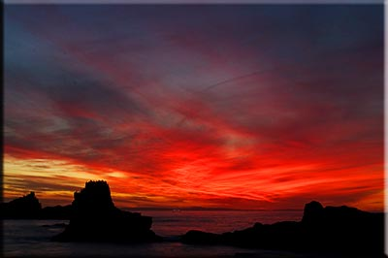
Time of day: golden hour
Notes:
-As a general rule of thumb, if you want the absolute BEST quality of light for your outdoor images, there are 2 times of day to shoot: dusk and dawn. Period. All those incredible images you see in Nat Geo, of mountains and volcanos and shit? All shot during what photographers call the “golden” hours. It is the first and last hour of light during the day. Does that mean you can only get good photos for 2 hours? No. But if you plan you shoots closer to these times, your colors will be richer, warmer, and your images more dramatic. The difference between the shot everyone has, and the shot you get may just be the time of day that you shoot it.

Slide 20
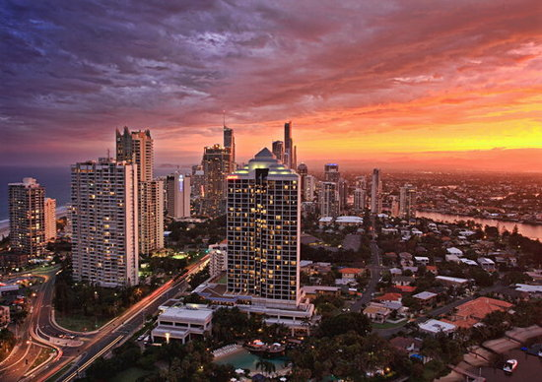

Slide 21
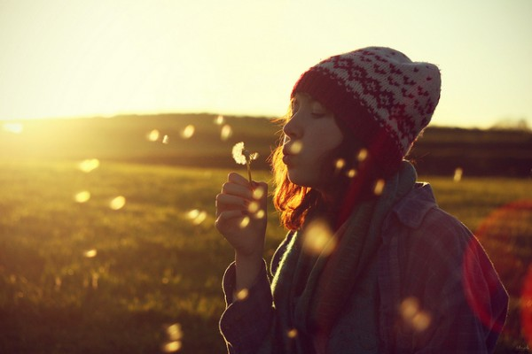

Slide 22
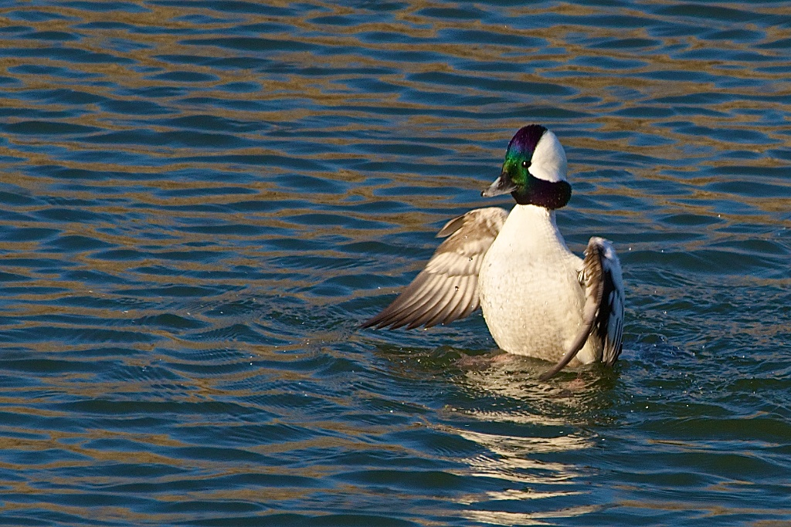
Top light
Notes:
-Top Lighting: Noon sun (often causes hard light situation). This is when the sun is highest, in the middle of the day, and causes a “flat” image. The image loses all 3deminsional effects. Shadows are very short and extremely dark. This can cause for striking photos, especially if you are photographing graphic patterns, but for the most part it can seem unnatural. In pictures of people, it causes the eye sockets to darken, and the chin to cast an unflattering shadow

Slide 23
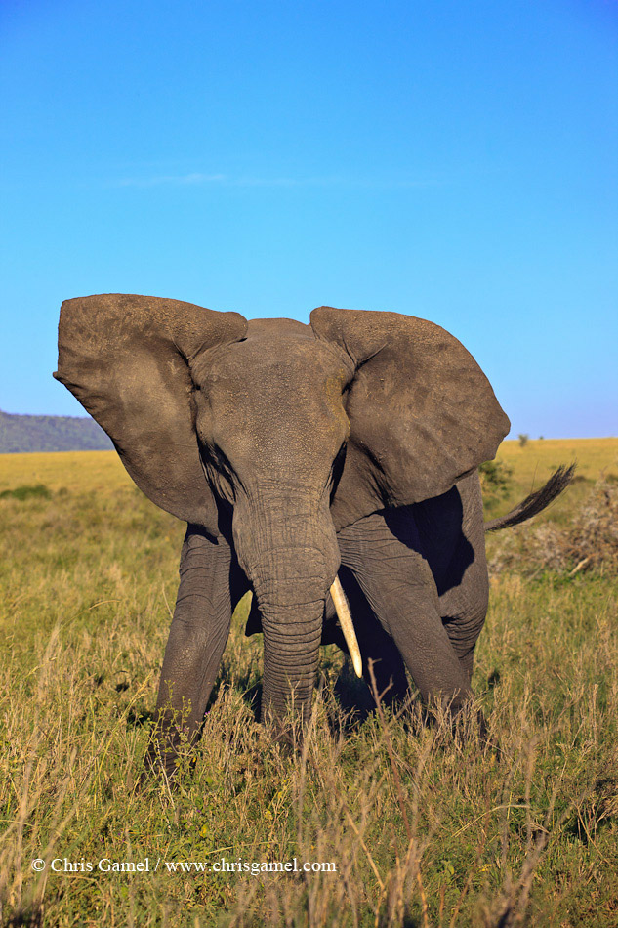
Front light
Notes:
Frontlighting: When the sun is behind the photographer’s back. The light strikes the subject from the front, in an even way. This is the first rule of photography “Keep the sun at your back”. This is easy to photograph, but sometimes the results are less than exciting. This, like top lighting, can cause the image to look flat. If people are in the image, they are often squinting because the sun is in their eyes. Like top lighting, this is often a “hard” light situation (unless you are working in the golden hours)

Slide 24
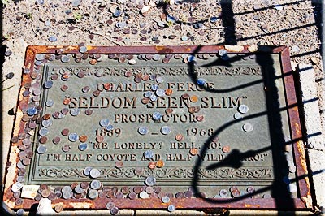
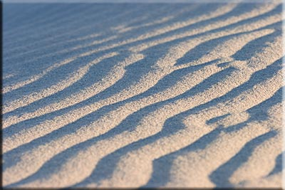
Side light
Notes:
Sidelighting: When the sun is striking the subject from the side, this emphasizes contrast and helps with texture and contours. This is great for objects buildings and animals, but for people it is almost never flattering for portraits because of long shadows. This also can cause a high contrast image.

Slide 25
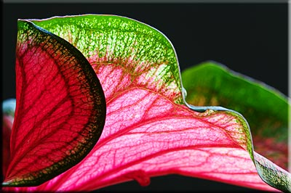
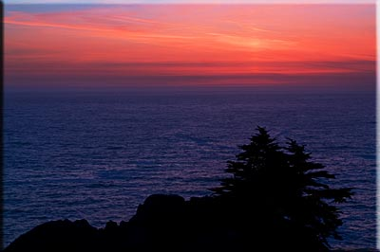
Back light
Notes:
Backlighting: the light is behind the subject. But this can cause the subject to be silhouetted. Contrast is generally extreme, and in some causes the subject may be “haloed” by the light. For translucent subjects like leaves, this type of lighting can produce beautiful effects and the impression of a shimmer in the leaves. When shooting with a point and click, you can use a “fill-flash” to prevent the silhouette of the subject, but this can flatten the image.

Slide 26
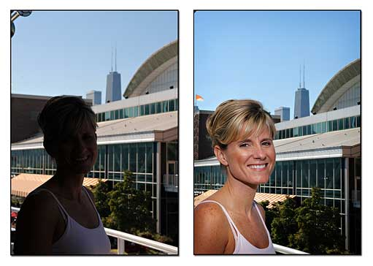

Slide 27
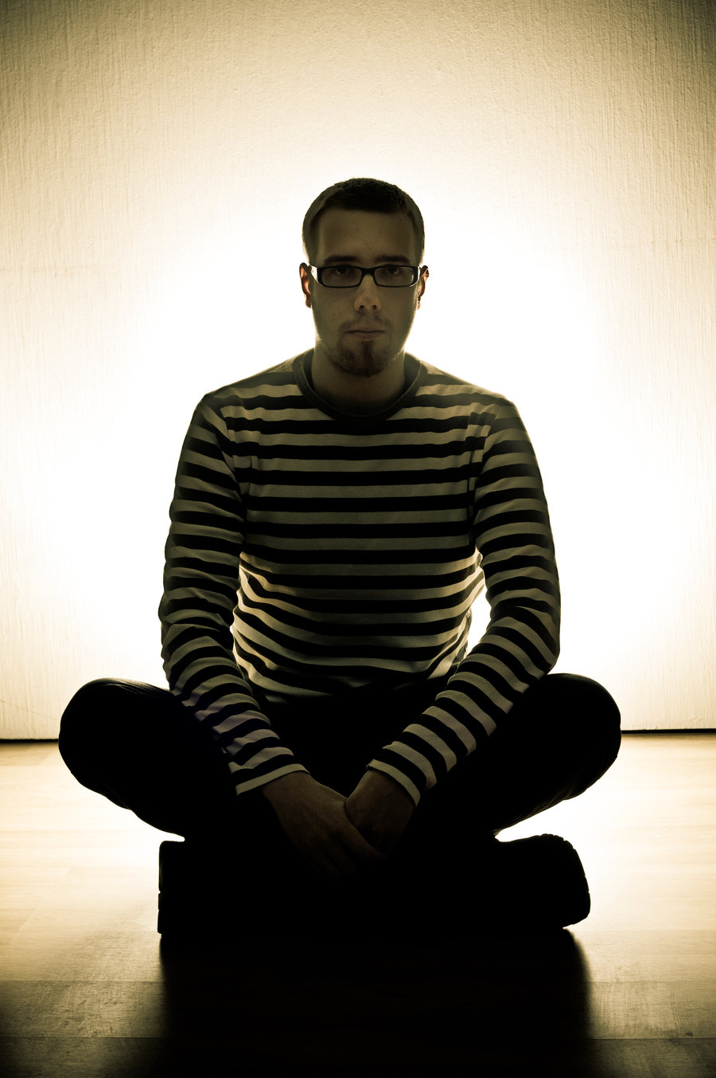
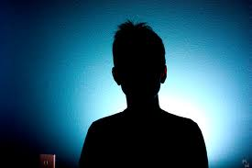

Slide 28
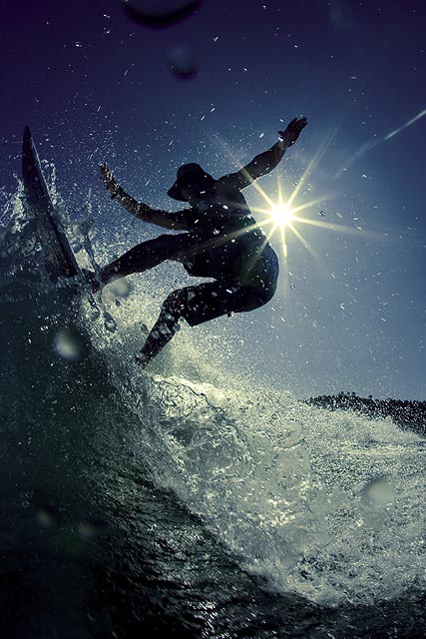

Slide 29
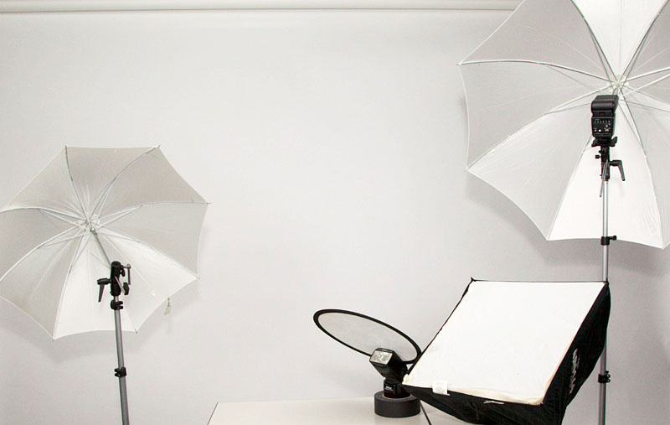
Light modifiers

Slide 30
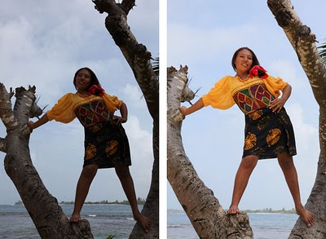
Reflectors
Notes:
Reflector: In photography and cinematography, a reflector is an improvised or specialised reflective surface used to redirect light towards a given subject or scene. Also called a “bounce card” it helps to fill in light. You can use many homemade objects to get this affect: tin foil, (reflects and amplifies light) white foam core, (bounces light) black foam core (absorbs light)

Slide 31
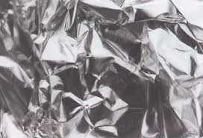
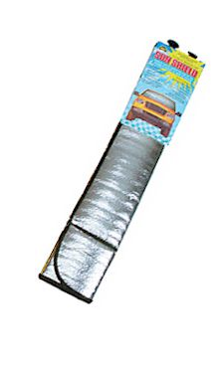
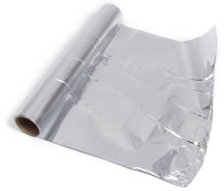
Homemade options:

Slide 32
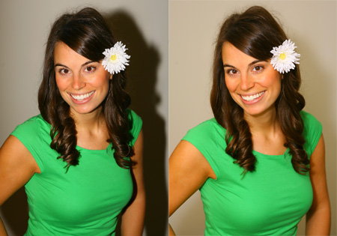
Diffusers
Notes:
Diffuser: is any device that diffuses or spreads out or scatters light in some manner, to give soft light. Diffuse light can be easily obtained by making light to reflect diffusely from a white surface, while more compact optical diffusers may use translucent objects. You can make a diffuser by using layers of plastics, wax paper, light weight fabrics. Heavier fabrics can be used too, but they will cut out a LOT of light. Tissue paper

Slide 33
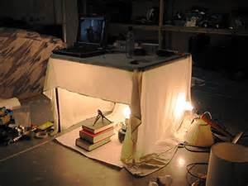
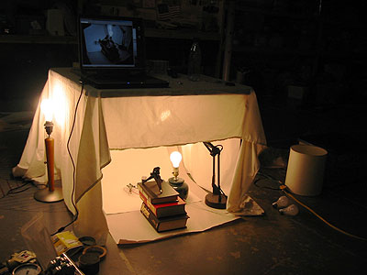
Homemade options:

Slide 34
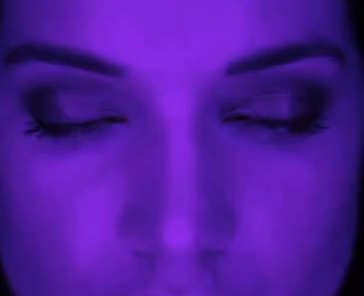
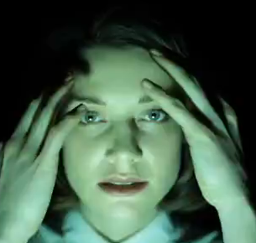
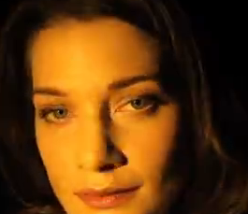
Colored lights
Notes:
http://www.videofantastica.com/view_video/130506/

Slide 35
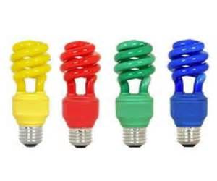
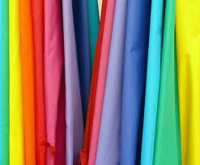
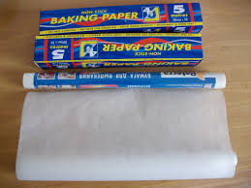
Homemade options:
Notes:
Paint on parchment or baking paper. Colored bulbs. Colored fabric.

